Slide 1
Understanding Sign-language with Neural Networks
Hugo Domingos 98502
Bernardo Falé 93331

Slide 2
Motivation
Sign language is the primary mode of communication for millions of people
Understanding sign-language is not a universal skill
Building a system that recognizes hand gestures and sign language can be very useful to facilitate the communication between speech-able and speech impaired people

Slide 3
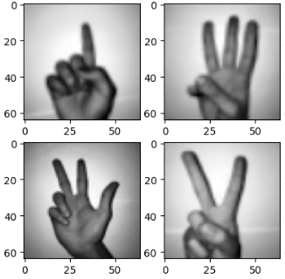
Data-set explanation
2062 images of sign-language digits
Image size: 64x64
Color space: Grayscale
Number of classes: 10 (Digits: 0-9)

Slide 4
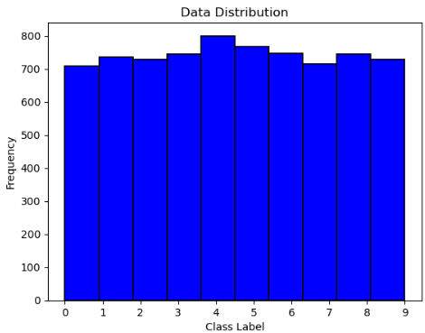
Data pre-processing
Data augmentation
Increase training set by 300%
Apply small changes
Feature selection
PCA
Normalization
Z-score

Slide 5
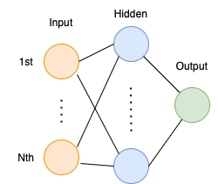
Model 1 - Architecture
Different number of features
Different number of hidden units
One-hot encoding of the output
Sigmoid activation function

Slide 6
Model 1 - Training
Fed the data set as whole
Splitted the data set
80% for training
20% for testing
Feature selection - PCA
Normalization - Z-Score
Random weight initialization - Xavier initialization

Slide 7
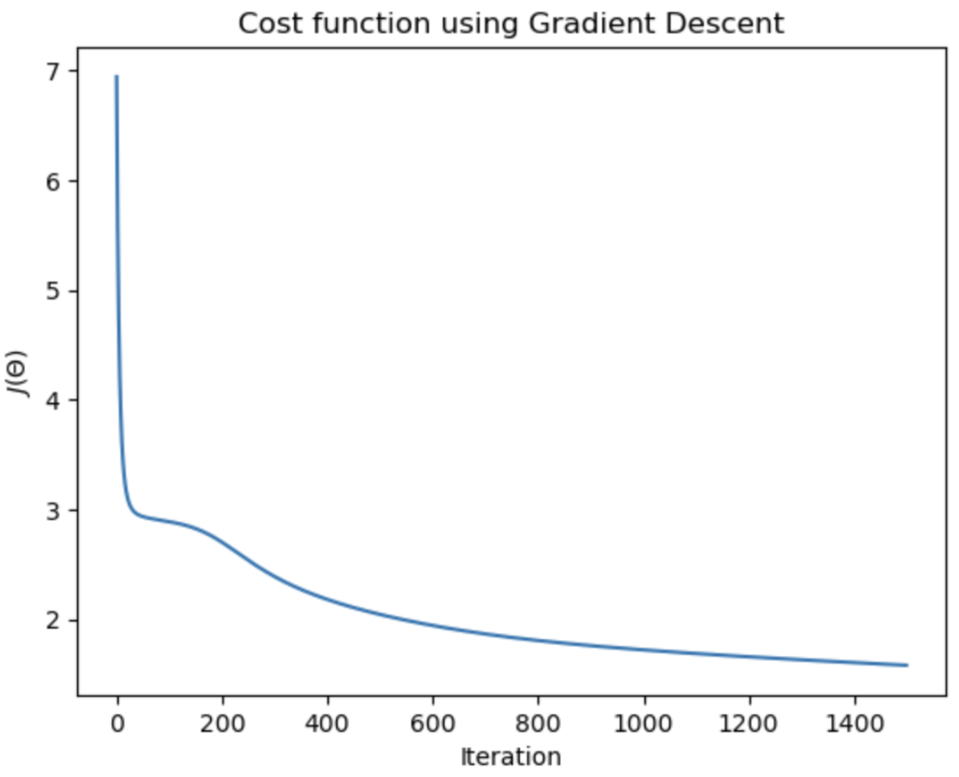
Model 1 - Results

Slide 8
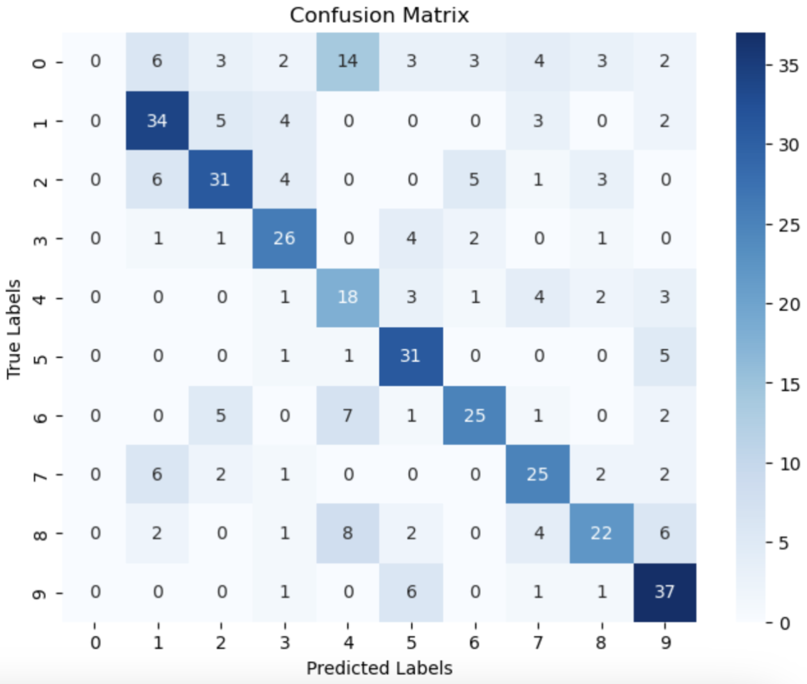
Model 1 - Results
Accuracy
Train - 65%
Testing - 64%

Slide 9
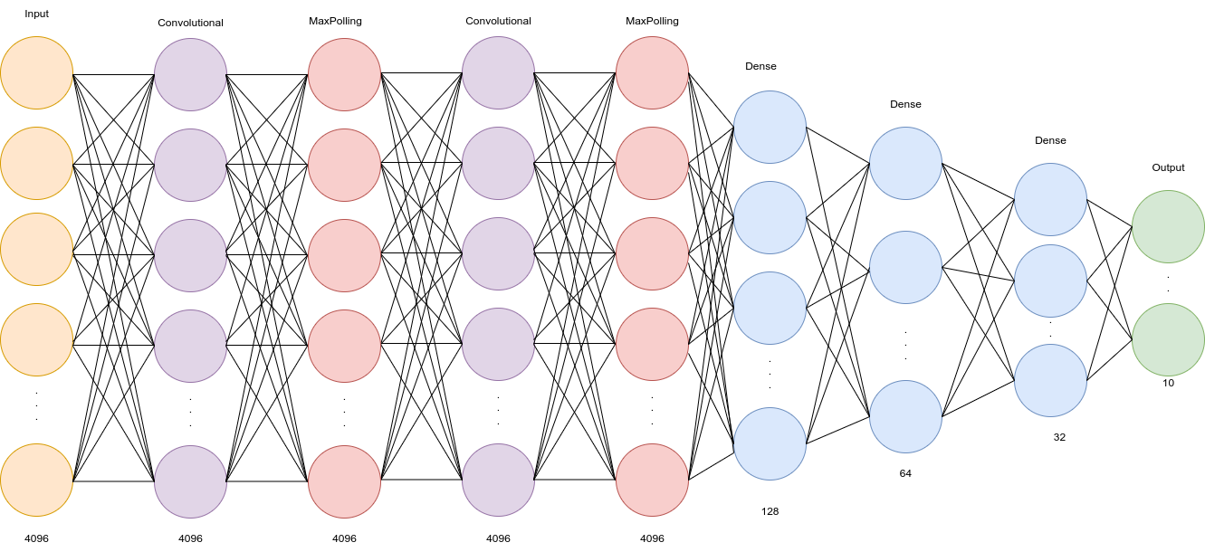
Model 2 - Architecture
Convolutional Layers
32/64 7x7 filters
Activation function: ReLU
Max Polling Layers
2x2
Dense Layers
Activation function: ReLU
Output Layer
Activation function: Softmax
10 classes

Slide 10
Model 2 - Training
Data splitting:
Train, Validation, Test
Mini-batch
Batch size: 10
Epochs: 40
Early Stop
Stops training when Loss on validation data stops decreasing
Adaptive Learning Rate
Starting at 0.001
Reduces by half when detects plateau
Cost function:
Categorical cross entropy

Slide 11
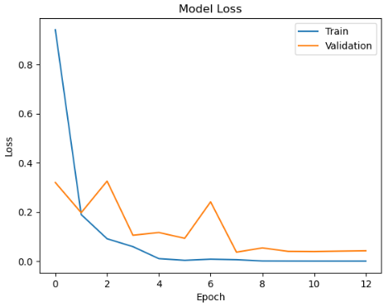
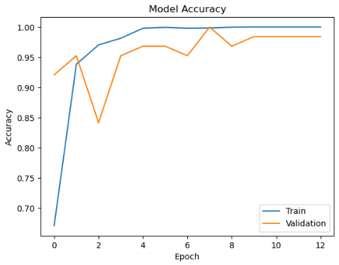
Model 2 - Results
Loss
Train: 7.57 e-05
Validation: 0.0420
Accuracy
Train: 100%
Validation: 98.5%
Test: 97.9 %

Slide 12
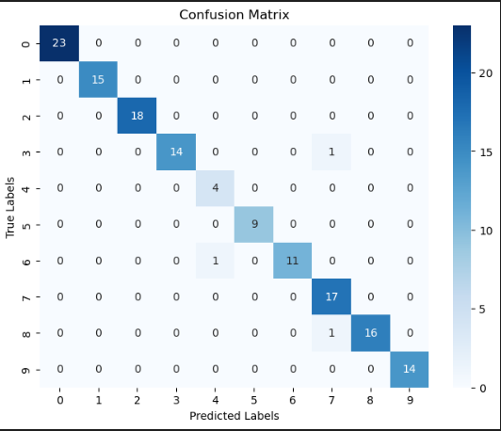
Model 2 - Results
Loss
Train: 7.57 e-05
Validation: 0.0420
Accuracy
Train: 100%
Validation: 98.5%
Test: 97.9 %

Slide 13
Conclusion
Complexity of models in Neural Networks
Convolutional Neural Networks are well suited for image classification
Data augmentation help us achieving better results
Trade-off between accuracy and training time
Mini-batch
Feature selection

